Slide 1
Past and Present Motivations for Immigration
By: Suzanne and Amy
(With Help from our Mentor, Maggie)

Slide 2
Why do people immigrate to America?
Forced Immigration (Slavery)
For Escaping Political Persecution
For Political Freedom
For Religious Freedom
For Economic Opportunities
For Better Education

Slide 3
Motivations for immigration
The motivations for immigration have changed over time. The first settlers came to America in search of religious or political freedom. It was also because they came against their own will, by force. Starting in the mid - 19th century, people chose to immigrate primarily in search of better economic opportunities.

Slide 4
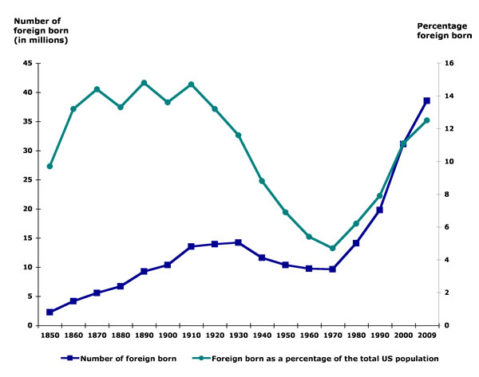
The Past – Present

Slide 5
1850 to 2009 Population of Foreign in US
Year | Number of foreign born | Foreign born as a percentage of the total US population
1850 | 2244602 | 9.7
1860 | 4138697 | 13.2
1870 | 5567229 | 14.4
1880 | 6679943 | 13.3
1890 | 9249547 | 14.8
1900 | 10341276 | 13.6
1910 | 13515886 | 14.7
1920 | 13920692 | 13.2
1930 | 14204149 | 11.6
1940 | 11594896 | 8.8
1950 | 10347395 | 6.9
1960 | 9738091 | 5.4
1970 | 9619302 | 4.7
1980 | 14079906 | 6.2
1990 | 19767316 | 7.9
2000 | 31107889 | 11.1
2006 | 37547789 | 12.5
2007 | 38059694 | 12.6
2008 | 37960935 | 12.5
2009 | 38517234 | 12.5

Slide 6
The Past
Religious Freedom – Pilgrims in 1620, Puritans 1630-1640
Force – Slavery in the new world 17th-19th century
Economic Opportunity – European and Asian Migration in 19th century

Slide 7
The Present
Economic Opportunity – Hispanics/Asians in America:
Today, people of Hispanic descents make up about 23% of the US population. This is approximately 9.6 million people. From 1970 - 2007, more than 10 million Mexicans migrated to the States in search of better wages. People also migrated in search of educational opportunity, which lead to better economic opportunities.
People still immigrate for other reasons; whether for political reasons or against their will. Economic opportunity is still the dominant reason.

Slide 8
Closing - Conclusion
The motivations for immigration have changed over time. In the past, people came in pursuit of greater religious freedom which goes along with the Puritans and Pilgrims. Many Africans were forcibly introduced to the States and enslaved. The mid-19th century also saw a great number of immigrants from Western Europe. All these individuals came in search of better economic opportunity and to escape from poverty. In recent years, the largest wave of immigrants have come from Latin American countries. These people came in search of better economic opportunity. While there are other reasons for migration today, we still believe that economic opportunity constitutes the greater theme in immigration today.
DISCUSSION:
What do you think “Future Motivations” for immigration will be?
Why is it important to think about past and present motivations for immigration?

Slide 9
Resources:
http://island-memories.tripod.com/id1.html
http://www.npr.org/templates/story/story.php?storyId=128873444
http://online.wsj.com/article/SB10001424052970203554104577000263988738328.html?mod=googlenews_wsj

